Slide 1
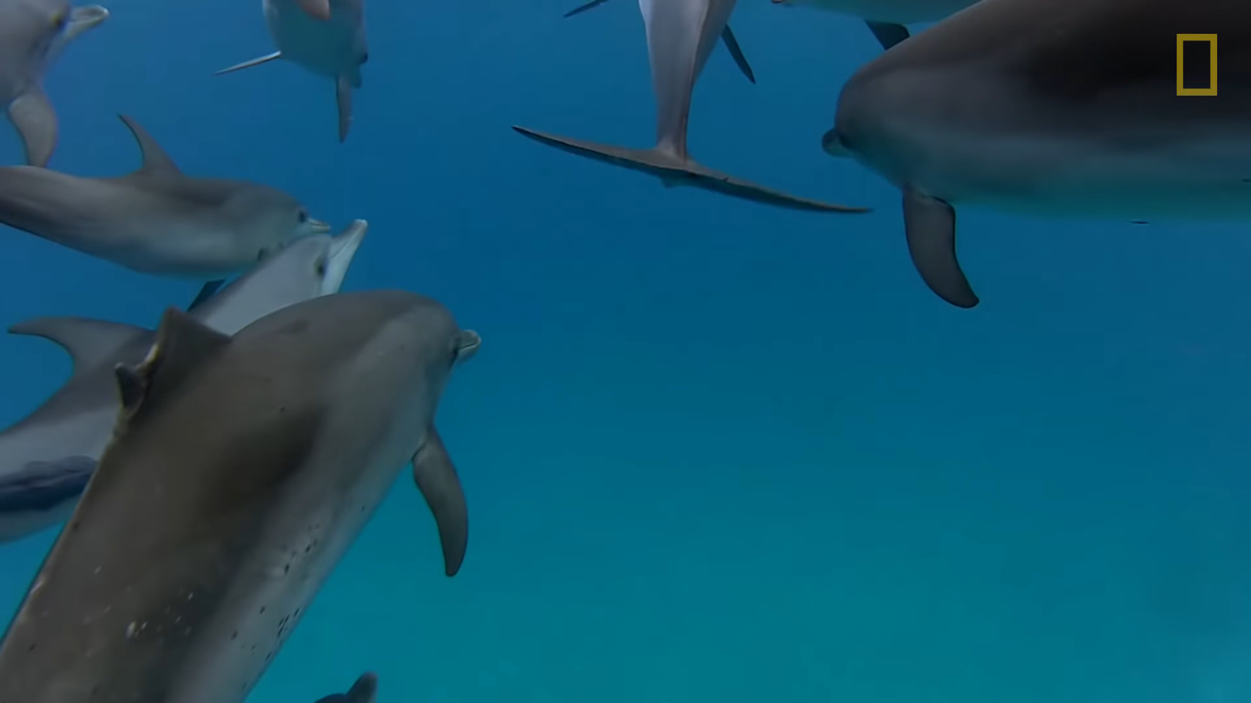
Dolphins

Slide 2
communication
Communication is how people and animals share information or feelings. As people, we use words, as well as smiles and other facial expressions.
Even though we may associate dolphins with smiling faces, is that how they communicate? Scientists have studied these smart, friendly animals, and have learned a lot about how dolphins think and the incredible ways they communicate.

Slide 3
How do Dolphins communicate
Dolphins make different kinds of vocal sounds. They can whistle, chirp, and even scream to show feelings, like when they are excited or afraid. Scientists believe that every bottlenose dolphin makes its own unique whistle like a signature.
The mother dolphin whistles to the calf when it's first born so that the baby will learn the mom's sound. When a baby dolphin is about one month old, it has its own signature whistle.
A dolphin can copy its friend's whistle, and will remember the sound after many years.

Slide 4
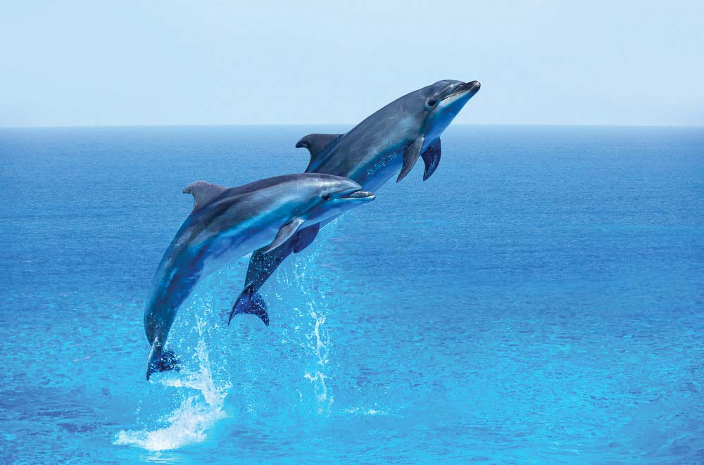

Slide 5


Slide 6
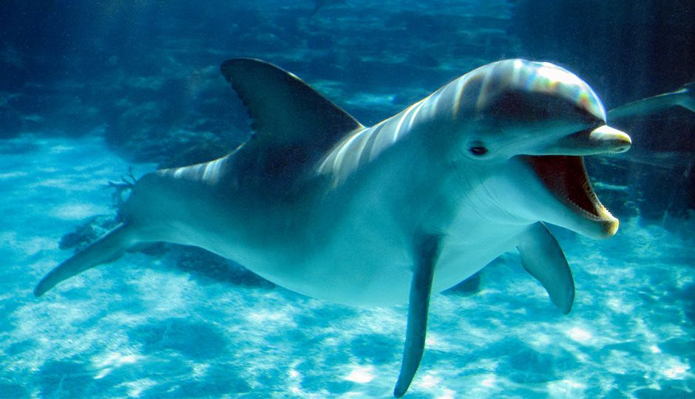

Slide 7
Thank you

